Slide 1
High resolution maps of PWV and 3D reconstruction of atmosphere refractivity
Giovanni Nico
g.nico@ba.iac.cnr.it
Consiglio Nazionale delle Ricerche (CNR)
Istituto per le Applicazioni del Calcolo (IAC)
Bari, Italy

Slide 2
Outline
Interesting features meterological datasets
Meteorological databases
SAR interferometry (new high-resolution meteorological data?)
GPS tomography

Slide 3
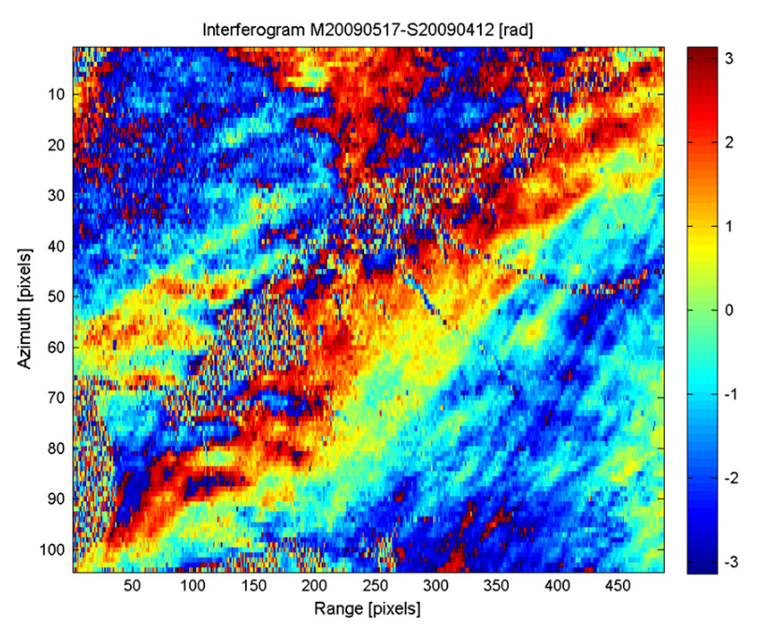
What am I interested in?
High resolution image of atmosphere
Laminar or turbolent flow ?
Are there frontal zones?
Are isolated anomalies related to some specific atmospheric phenomenon?
Linear features are related to transport of moisture in atmosphere?

Slide 4
What am I interested in?
3D images of atmospheric refractivity
Can I identify/retrieve specific patterns ?
Relevance
I could better study/identify different types of clouds:
Stratiform cloud
Small cumulus clouds
Cumulonimbus
Ice clouds
Deeper knowledge about atmospheric dynamics

Slide 5
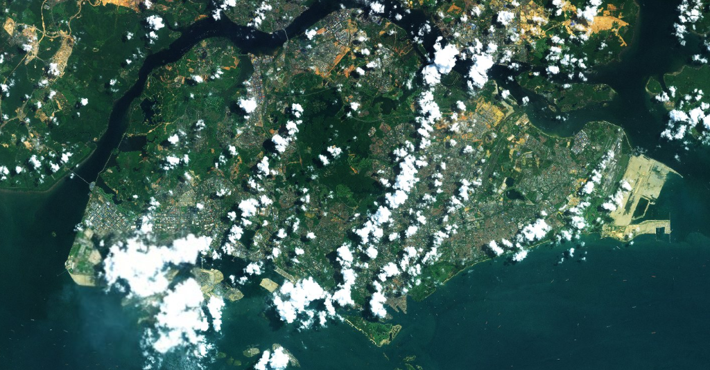
Active vs. passive RS images

Slide 6
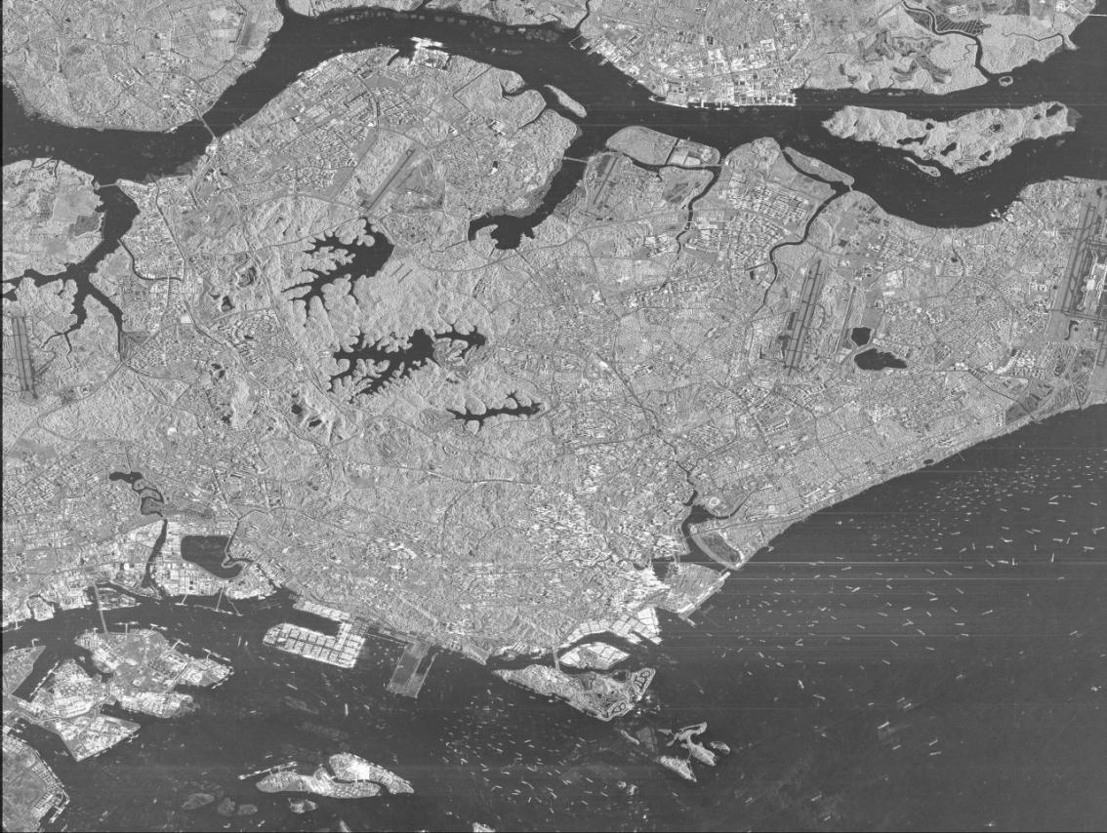
Active vs. passive RS images

Slide 7
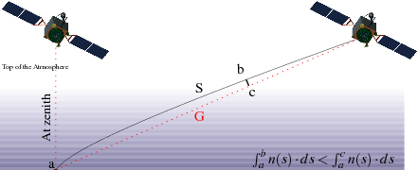
Interaction with atmosphere
Royal Observatory of Belgium. GNSS Research Group
Effect of the atmospheric refraction on microwave signal propagation in a horizontally stratified atmosphere in which the refractive index decreases with height: delay in the wave propagation

Slide 8
Meteorological databases
MODIS (Moderate-Resolution Imaging Spectroradiometer)
Satellite Terra (1999)
Satellite Aqua (2002)
36 spectral bands
0.4 – 15.0 μm
MOD05 Terra product
MOD07 Terra product
spatial resolution of 1x1
1 day-time acquisition
spatial resolution of 5x5
2 day and night acquisitions
The MODIS PWV product represents the total atmospheric column water vapor

Slide 9
Meteorological databases
AVHRR (Advaced Very High Resolution Radiometer)
spatial resolution of 1.1x1.1 km at nadir
ground swath of about 2000 km
6-8 acquisitions per day (by combining two operational satellites)
Five channels
C1 → 0.58 – 0.68 μm
C2 → 0.73 – 1.1 μm
C3 → 3.6 – 3.9 μm
C4 → 10.3 – 11.3 μm
C5 → 11.5 – 12.5 μm
AVHRR images can be used to get an overview of the general atmospheric situation, the position of frontal zones and the type of cloud cover
Combination of channels 1, 2 and 4
Cold cirrus clouds
Warmer medium and lower level clouds

Slide 10
Meteorological databases
Meteosat
spatial resolution of 5x5 km at nadir
1 acquisition per half an hour
Three channels
C1 → 0.5 – 0.9 μm
C2 → 5.7 – 7.1 μm
C3 → 10.5 – 12.5 μm
Water Vapor

Slide 11
Meteorological databases
Meteosat Third Generation (MTG)
It will carry the Flexible Combined Imager (FCI) with a spatial resolution of 1–2 km at the sub-satellite point and 16 channels (8 in the thermal band), and an infrared sounder (IRS) that will be able to provide unprecedented information on horizontally, vertically, and temporally (four-dimensional; 4-D) resolved water vapor and temperature structures of the atmosphere.
Humidity and temperature profiles will be generated on the vertical hybrid-sigma coordinates of the ECMWF forecast system (91 levels)

Slide 12
Meteorological databases
Global Atmospheric Models:
ERA-Interim (European Center for Medium-Range Weather Forecasts – ECMWF)
North American Regional Reanalysis (NARR)
Modern Era-Retrospective Analysis for Research and Application (MERRA)
Global and regional reanalysis of atmospheric data provide estimates of atmospheric variables several time a day at different pressure levels.

Slide 13
Meteorological databases
ERA-Interim is a atmospheric reanalysis of the ECMWF, following ERA-40. It provides estimates of temperature, water vapor partial pressure, and geopotential height along 37 pressure levels, on a global 0.7° grid, at 0:00, 6:00, 12:00 and 18:00 UTC daily, from 1989 to present.
NARR is a regional model that provides estimates of temperature, water vapor partial pressure, and geopotential height along 29 pressure levels, on a Northern Hemisphere Lambert Conformal Conic grid centered on the USA, at 0:00, 3:00, 6:00, 9:00, 12:00, 15:00, 18:00 and 21:00 UTC daily, from 1979 to the present.
MERRA is a global reanalysis, providing temperature, water vapor partial pressure and geopotential height along 42 pressure levels, on a global grid (0.5° along longidute and 0.75° along latitude), at 0:00, 6:00, 12:00, and 18:00 UTC daily, from 1979 to present.

Slide 14
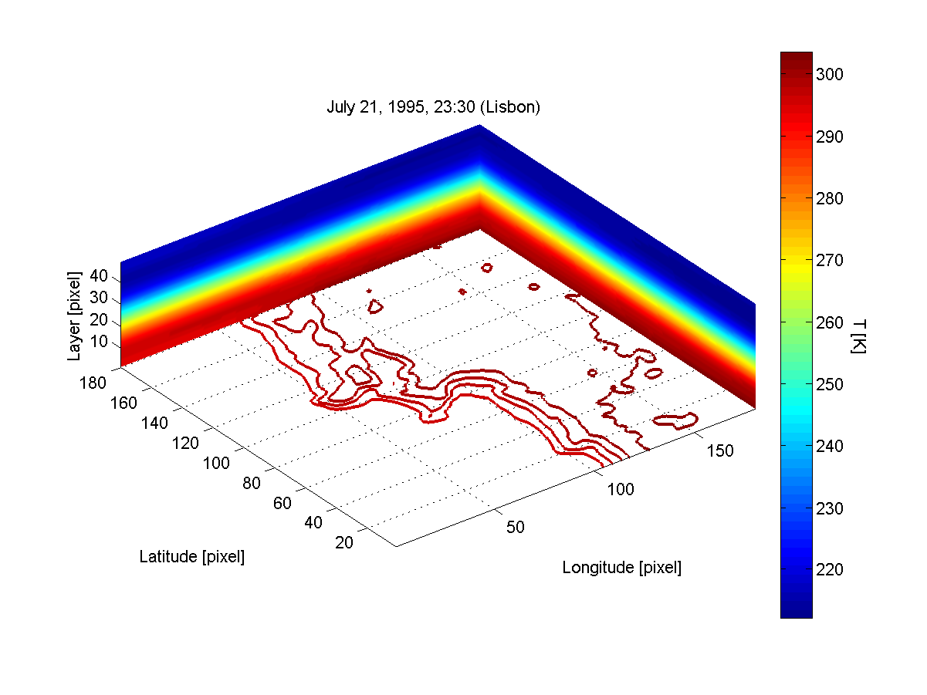
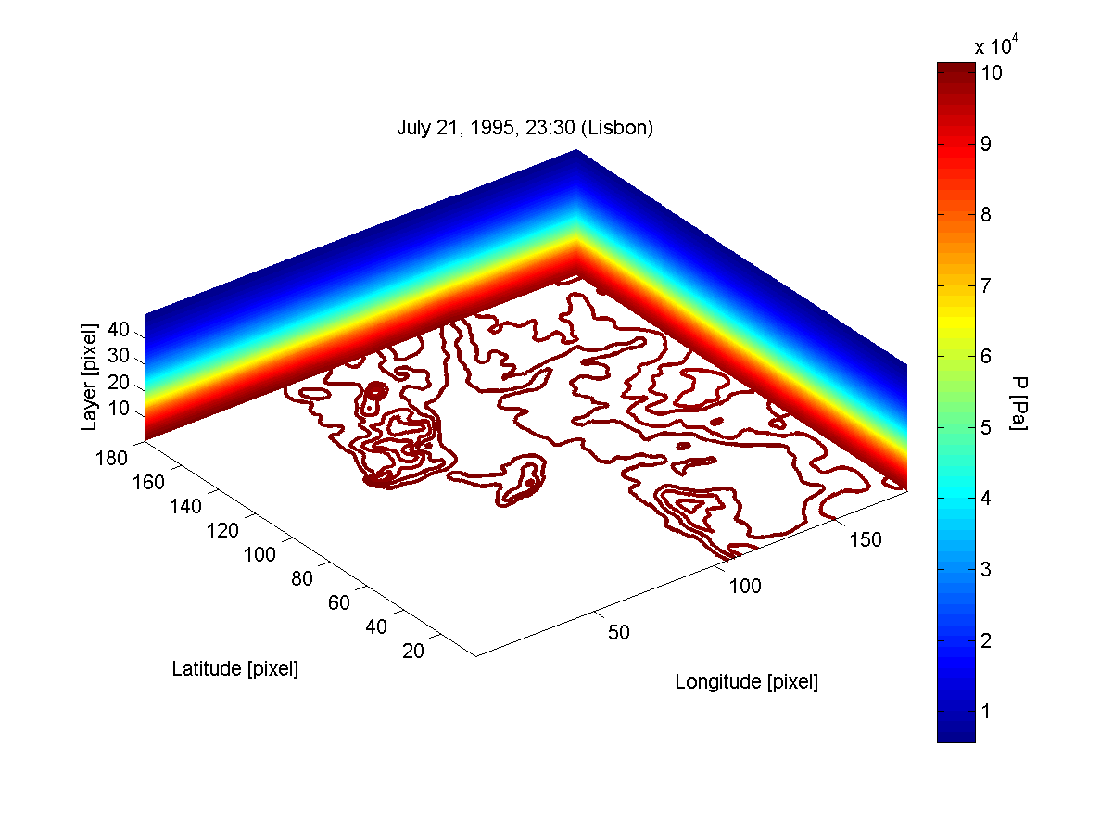
Numerical Weather Models (NWMs)
The Weather Reseach & Forecasting (WRF) model can be used to generate 3D field of atmosphere temperature, pressure, geopotential, water vapor fraction and liquid water.
Spatial resolution 1kmx1km

Slide 15
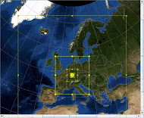
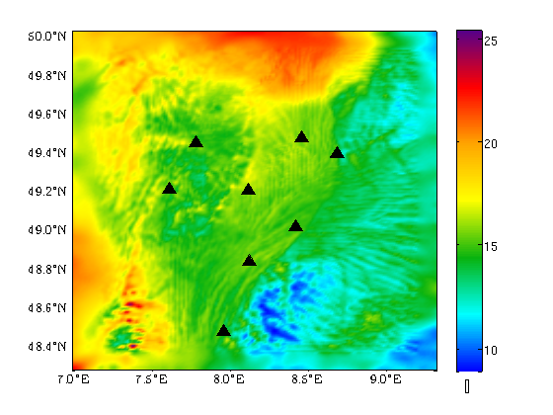
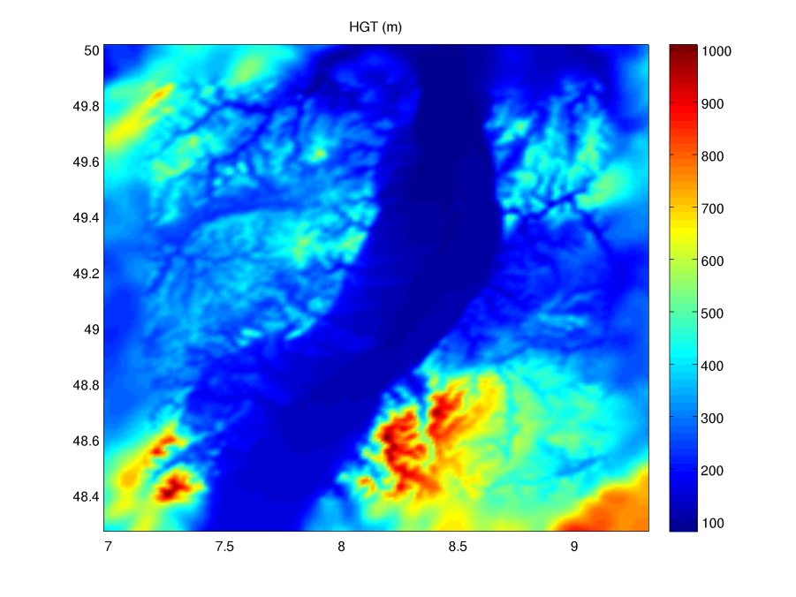
NWMs ➔ atmospheric phase delay
GPS stations overlaid to delay map

Slide 16
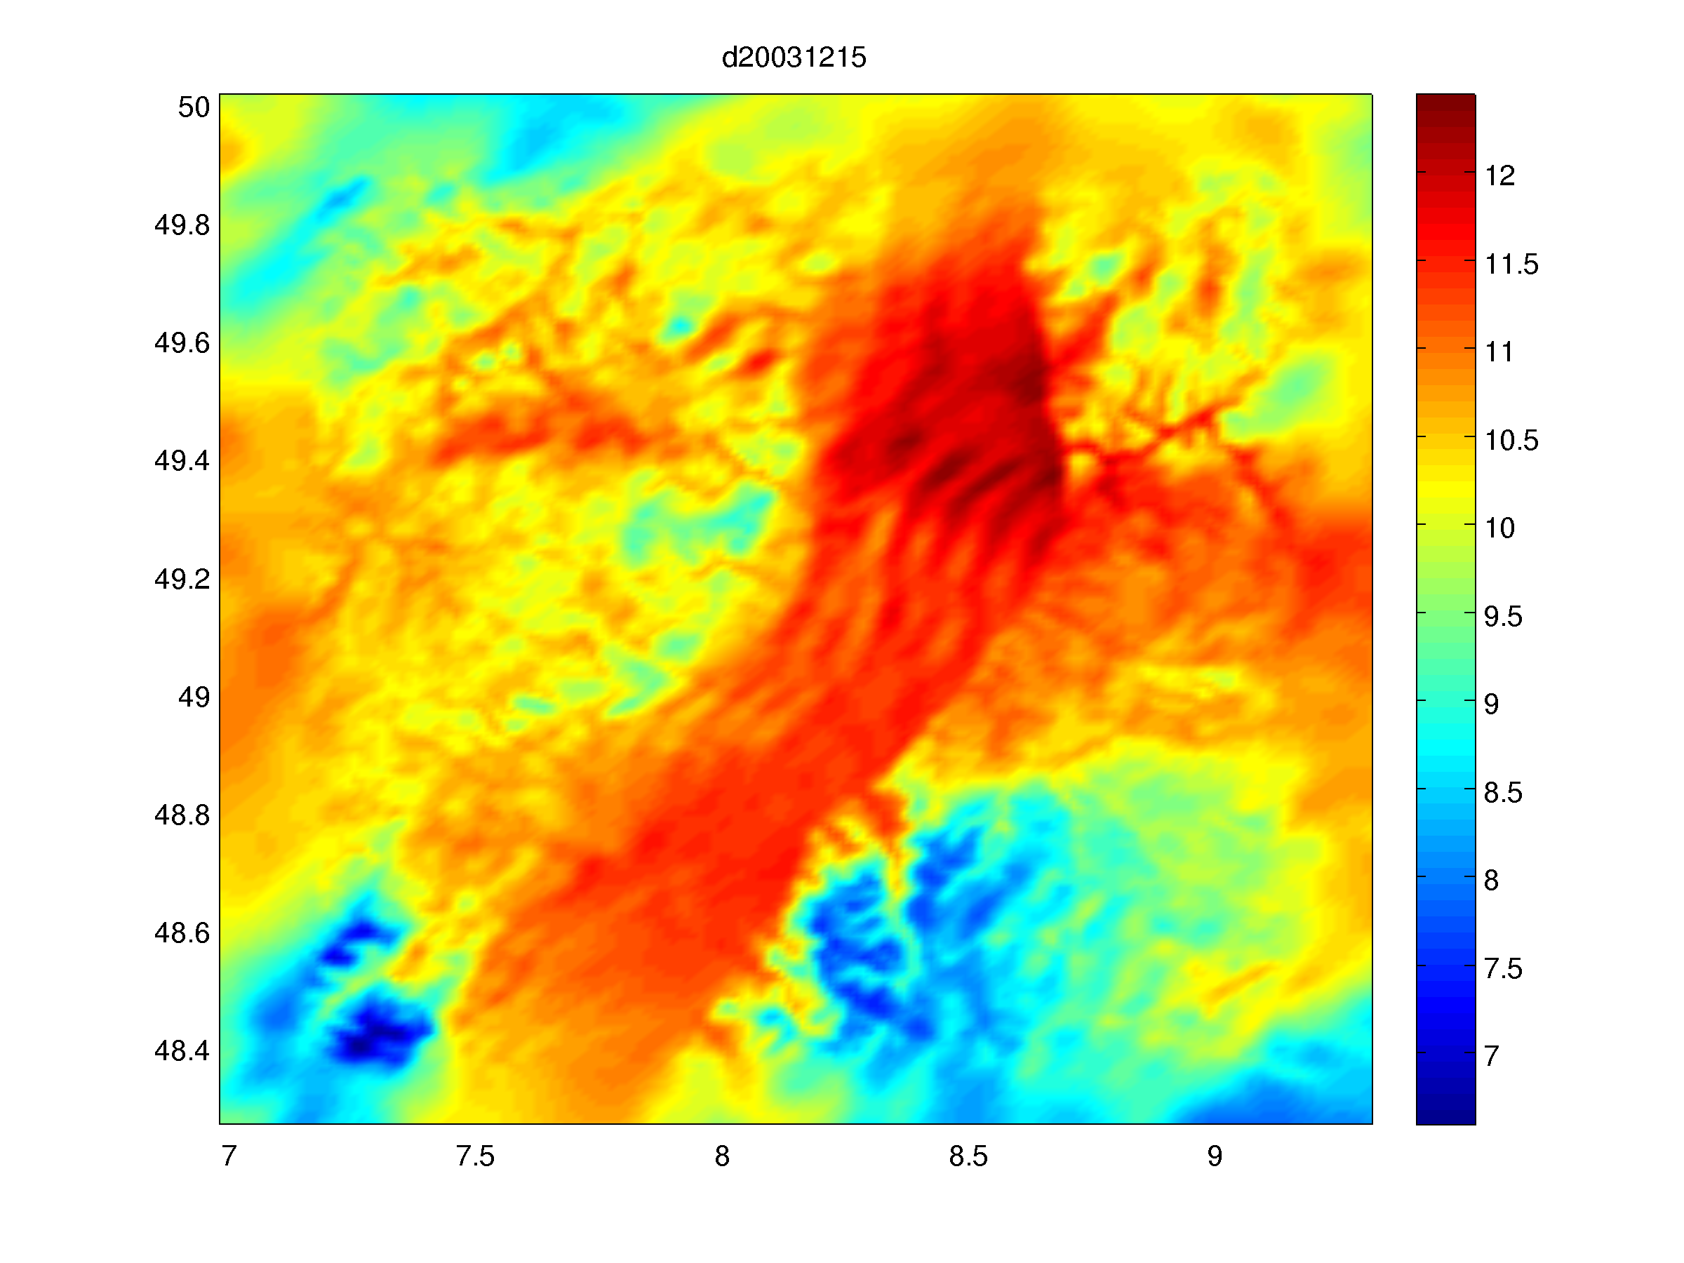
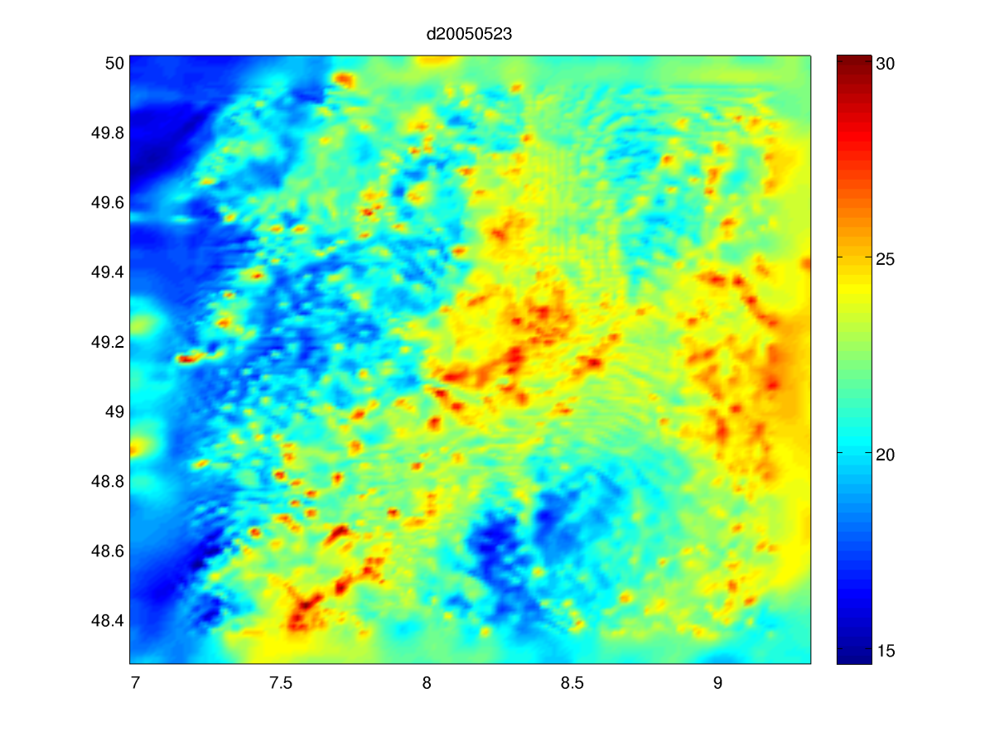
NWMs ➔ atmospheric phase delay
Stratified atmosphere?
Turbolent atmosphere?

Slide 17
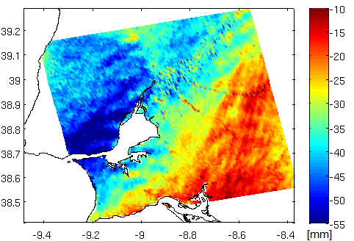
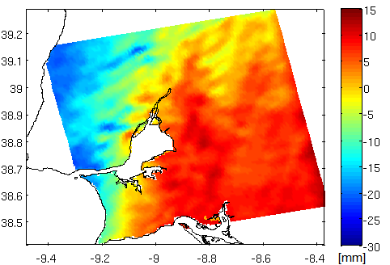
Meteorological databases
WRF
SAR interferometry

Slide 18
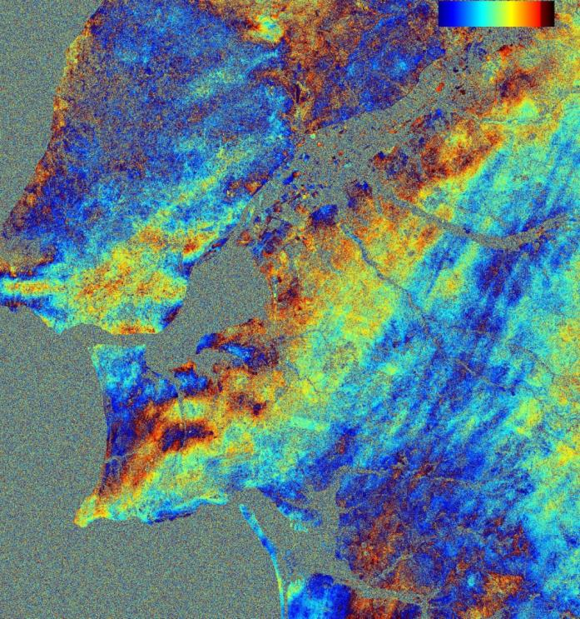
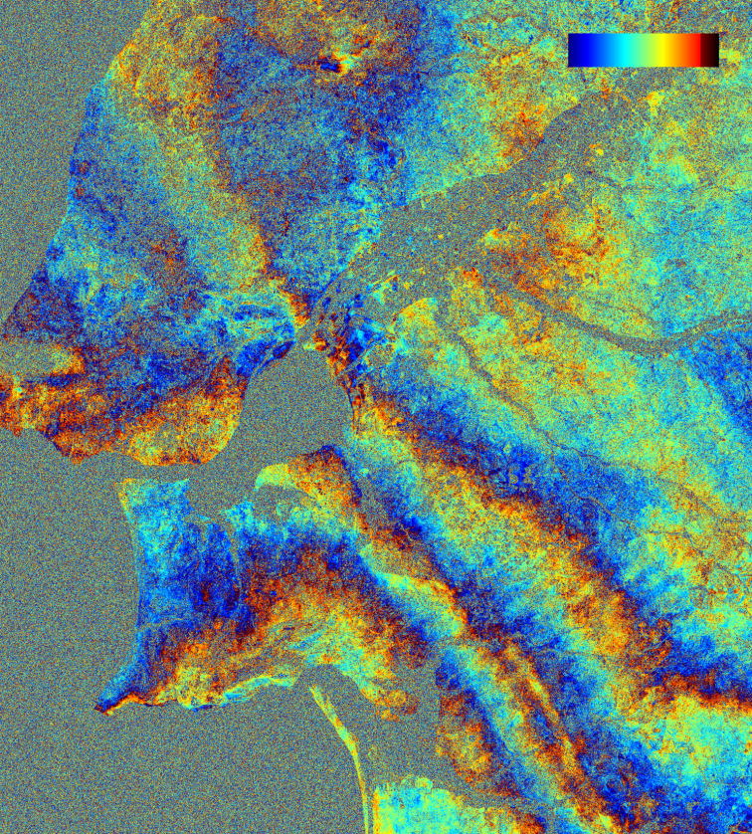
Atmospheric signal in radar interferometric phase images?

Slide 19
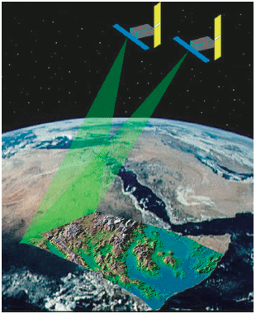
Synthetic Aperture Radar (SAR) Interferometry (InSAR)
Spaceborne radar satellites
Multiple observations of surface
• Simultaneously
• Spaced in time
Applications
• Hi-res topography
• Motions
• Crustal deformation
• Atmosphere

Slide 20
SAR interferometry
(MASTER) ←S₁(t)
(SLAVE) ←S₂(t)
D₂
D₁
Pixel = A₂e^{iϕ2}
Pixel = A₁e^{iϕ1}

Slide 21
InSAR phase contributions
φ^{k}
φ_{Displacement}
φ_{topo}
φ_{atmo}
φ_{noise}

Slide 22
Propagation delay in atmosphere

Slide 23
Precipitable Water Vapour and InSAR
Let us suppose to have an interferogram corrected for topography
where
The precipitable water vapor is
the total amount of water vapor
In a vertical column of the atmosphere if it would all condense
is the mapping function

Slide 24
Precipitable Water Vapour and InSAR
If terrain deformation can be neglected, InSAR can provide maps of PWV temporal
changes
A set of independent measurements of ΔPWV by a network of permanent GPS
stations can be used to calibrate InSAR measurements. Each station measures the
mean PWV in a circular area with a radius of about 3.8 km depending on the cut-off
angle set in the GPS processing. The idea is to use GPS estimates of PWV at the
acquisition times of master and slave SAR images to compute an independent set
of ΔPWV.

Slide 25
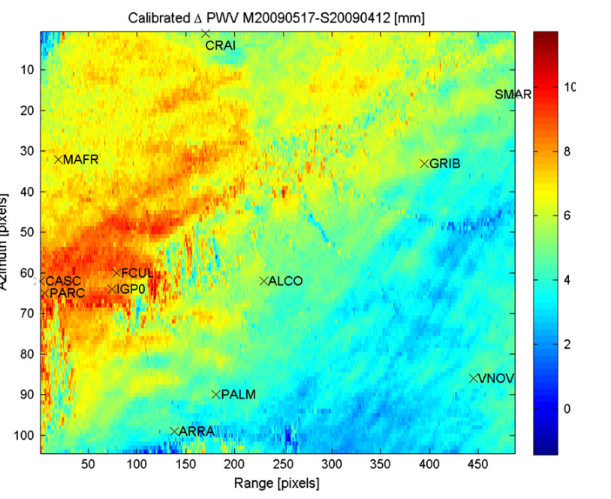
Precipitable Water Vapour and InSAR

Slide 26
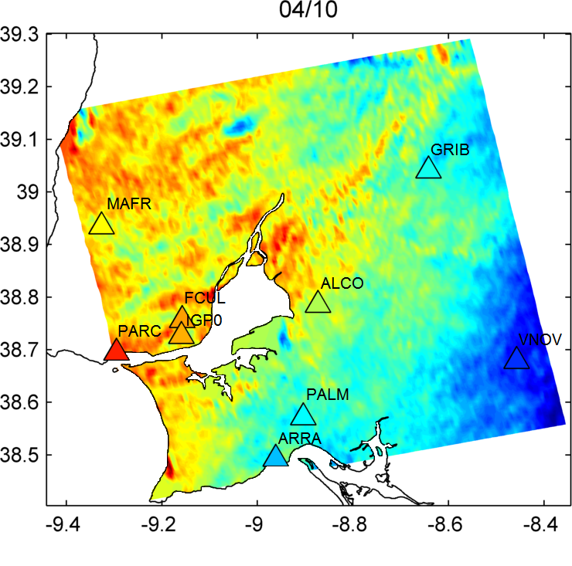
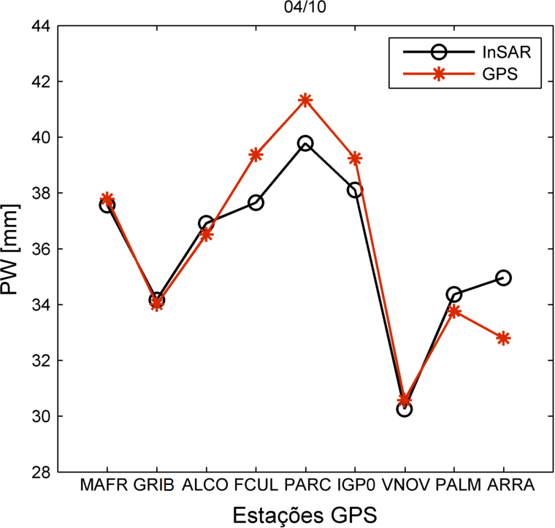
Precipitable Water Vapour and InSAR
30/08/2009 → 04/10/2009
Latitude [deg]
ΔPWV [mm]
Longitude [deg]
GPS stations

Slide 27
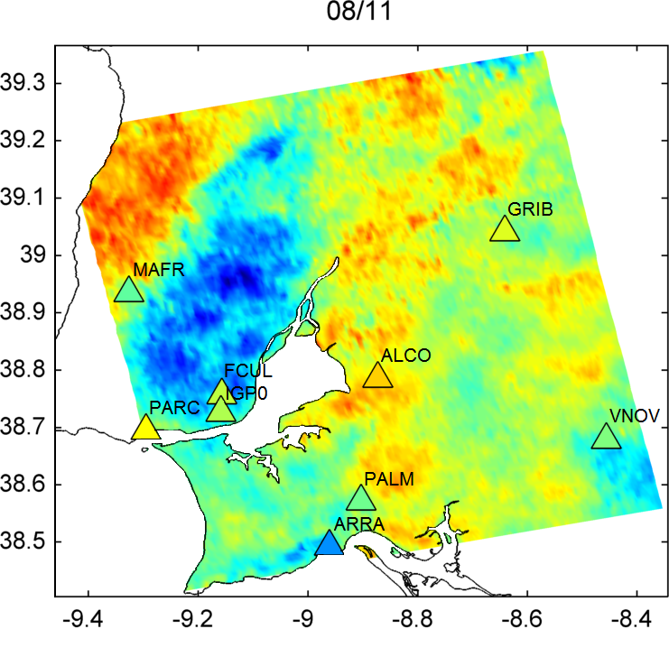
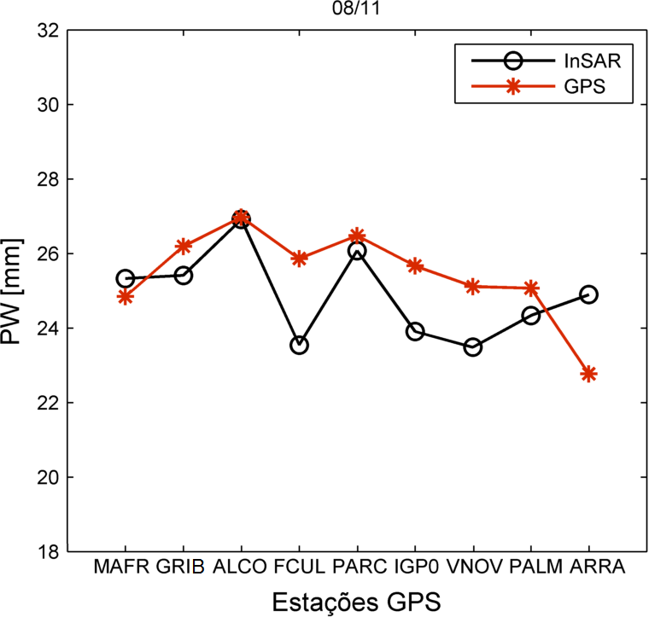
Precipitable Water Vapour and InSAR
04/10/2009 → 08/11/2009
Latitude [deg]
ΔPWV [mm]
Longitude [deg]
GPS stations

Slide 28
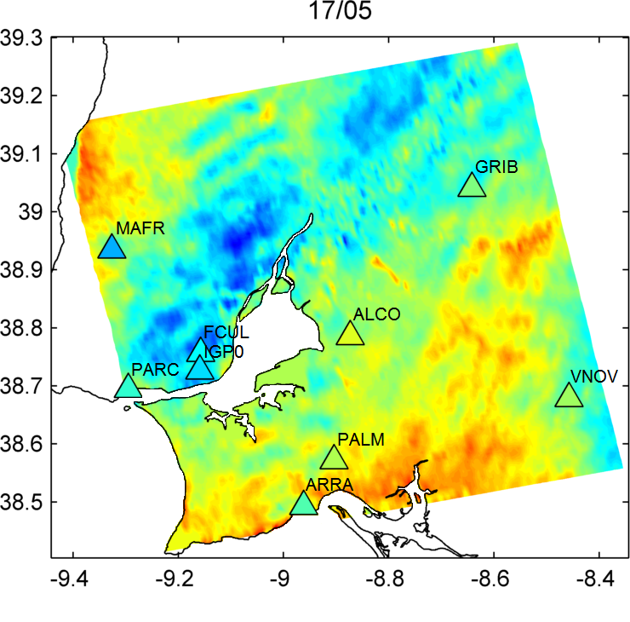
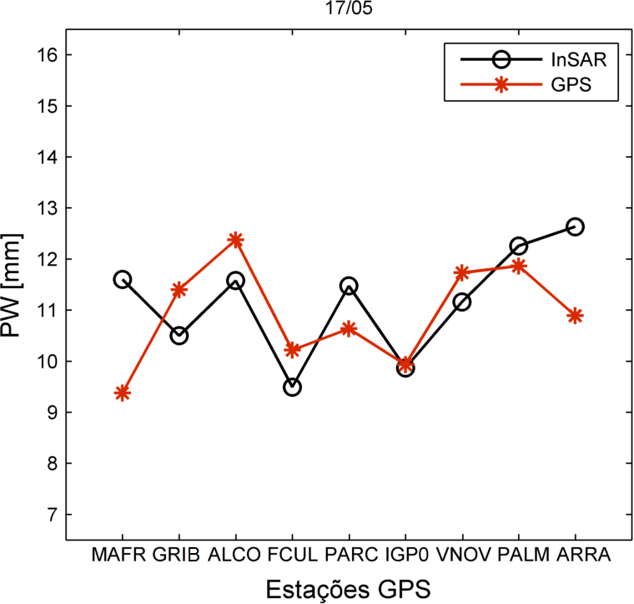
Precipitable Water Vapour and InSAR
12/04/2009 → 17/05/2009
Latitude [deg]
ΔPWV [mm]
Longitude [deg]
GPS stations

Slide 29
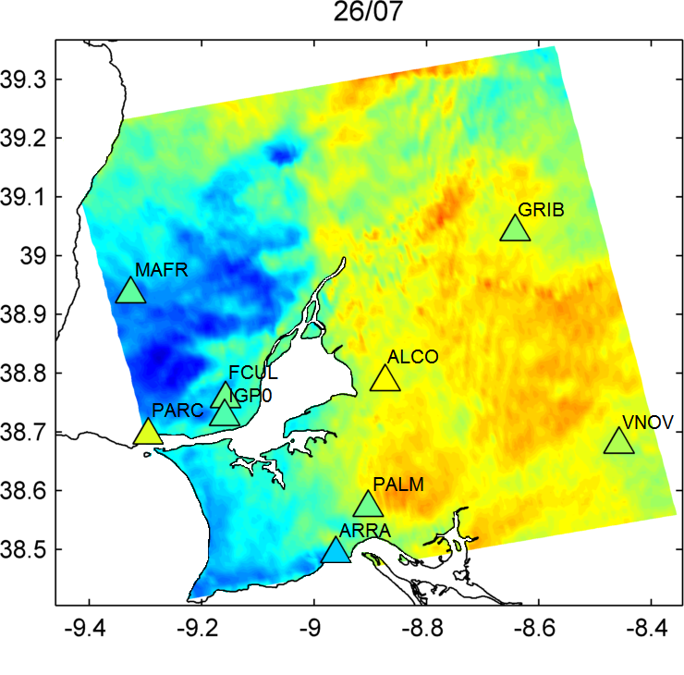
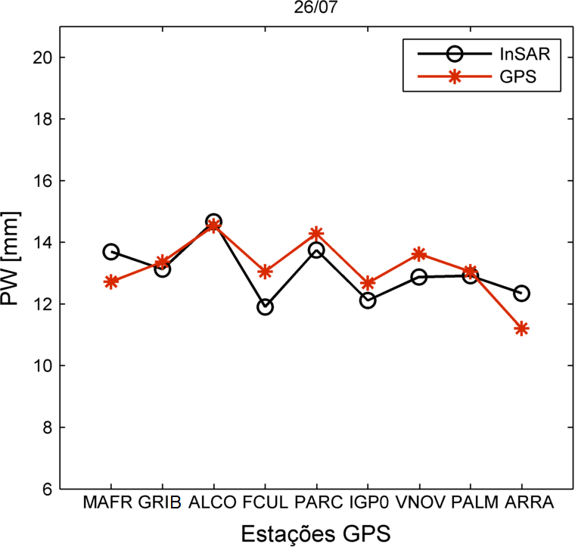
Precipitable Water Vapour and InSAR
21/06/2009 → 26/07/2009
Latitude [deg]
ΔPWV [mm]
Longitude [deg]
GPS stations

Slide 30
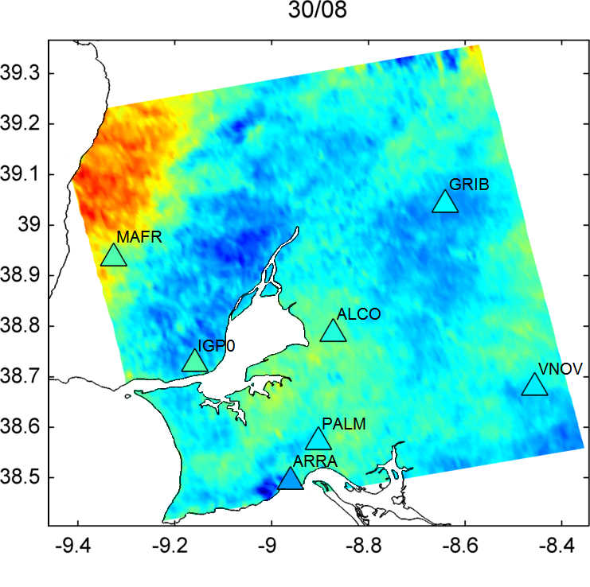
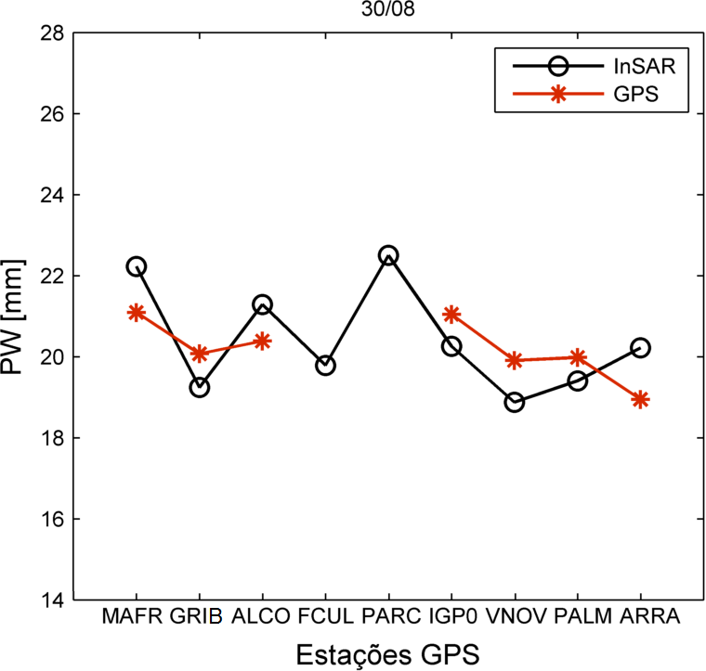
Precipitable Water Vapour and InSAR
26/07/2009 → 30/08/2009
Latitude [deg]
ΔPWV [mm]
Longitude [deg]
GPS stations

Slide 31
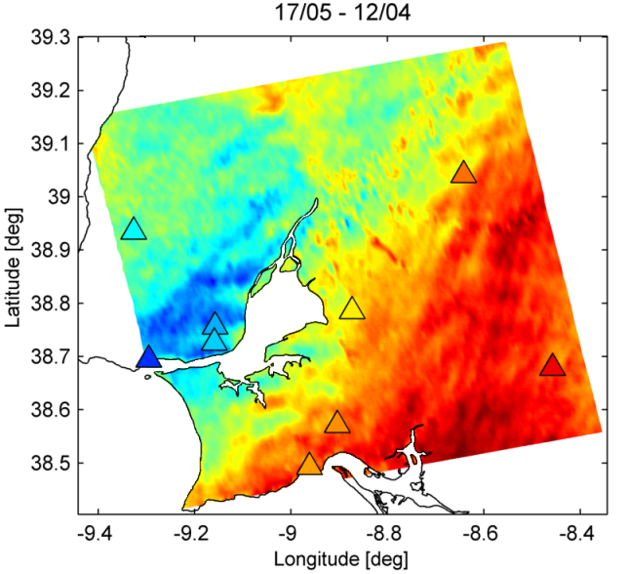
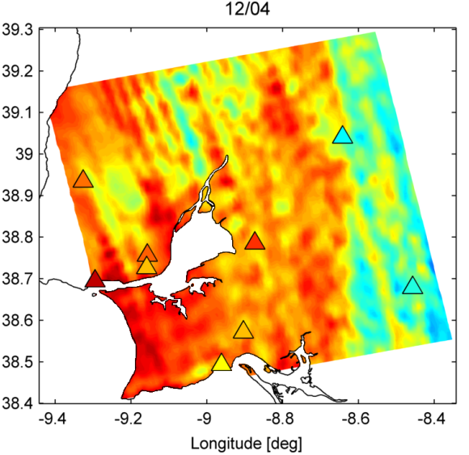
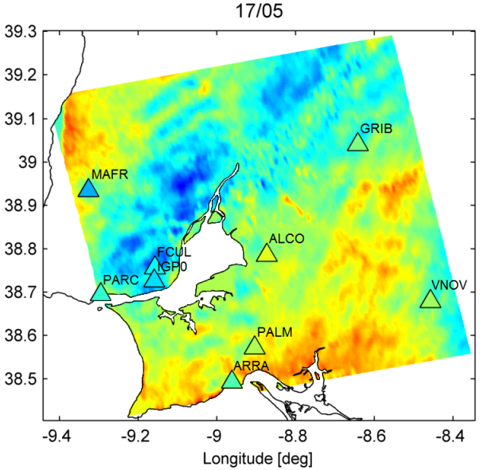
How can we estimate the absolute PWV?
Relative PWV
InSAR
17/05/09 – 12/04/09
Absolute PWV
WRF model
12/04/09
Absolute PWV
17/05/09

Slide 32
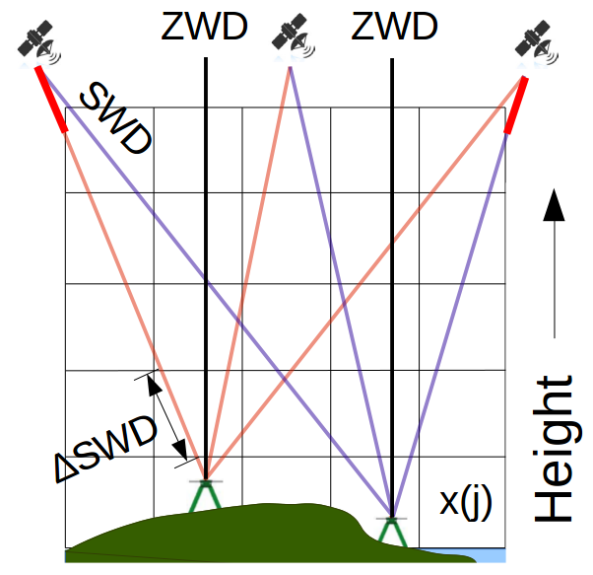
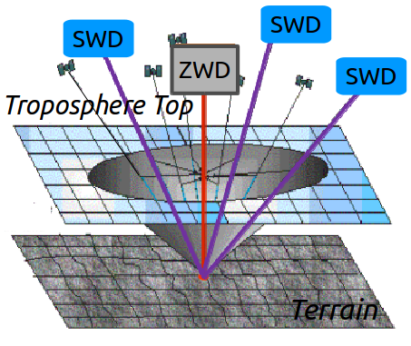
GNSS (Global Navigation Satellite System) tomography

Slide 33
GNSS (Global Navigation Satellite System) tomography
K₂ = 71.6 k mb⁻¹
Z⁻¹ = empirical inverse wet
compressibility factor
K₃ = 3.747 10⁵ k² mb⁻¹
unknown
refractivity
SWD
observations
3D tomographic grid model

Slide 34
GNSS (Global Navigation Satellite System) tomography
The A matrix is filled using a ray tracing algorithm to measure the sub-path distance travelled by the total SWD in each voxel
The main drawback of GNSS tomography formulation is its ill-posedeness resulting from the sub-optimal coverage of the grid model due to he GPS geometry properties ➔ the A matrix is not invertible due the large amount of zeros values ini correspondence of the empty voxels mainly in the lowerr part of the tomographic part of the tomographic model.
To overcome this problem a set of constraints or additional information concerning the grid model are added

Slide 35
GNSS (Global Navigation Satellite System) tomography
Each row of matrix B contains a constraint imposed to the tomographic model
The most common ones are weighted averages using horizontal and vertical smoothing functions or the inverse distance from the neighbors in each horizontal layer
Another useful contraint sets refractivity values to zero above a given height of the troposphere or impose that they follow an atmospheric standard profile.
Can we use meteorological databases to properly fill the A matrix?

Slide 36
GNSS (Global Navigation Satellite System) tomography
If a first guess solution N₀ of refractivity is available, a solution can be provided by the damped least square method
P = vector with the weight of each SWD observation
P₀ = error covariance matrix of the a priori solution N₀

Slide 37
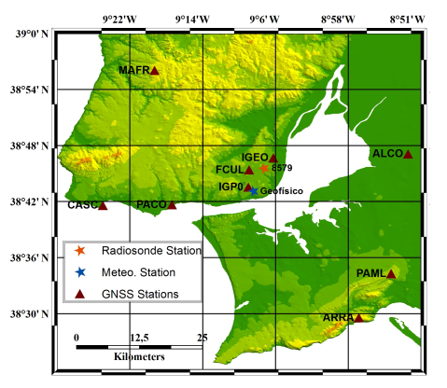
GNSS tomography

Slide 38
GNSS tomography + SAR interferometry
Units: g/m³
Doy 230 (17/8) 11:30

Slide 39
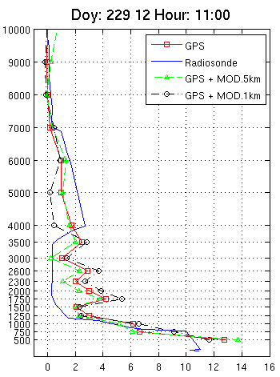
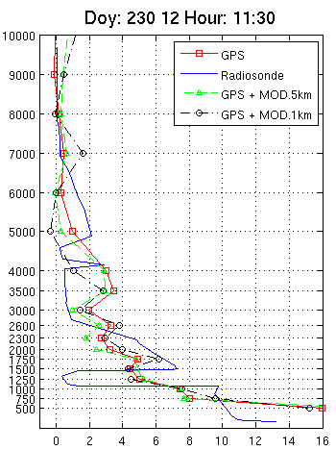
GNSS tomography + MODIS
Radiosonde: Strong vertical variability
Tomography: Smoother and smaller vertical variability

Slide 40
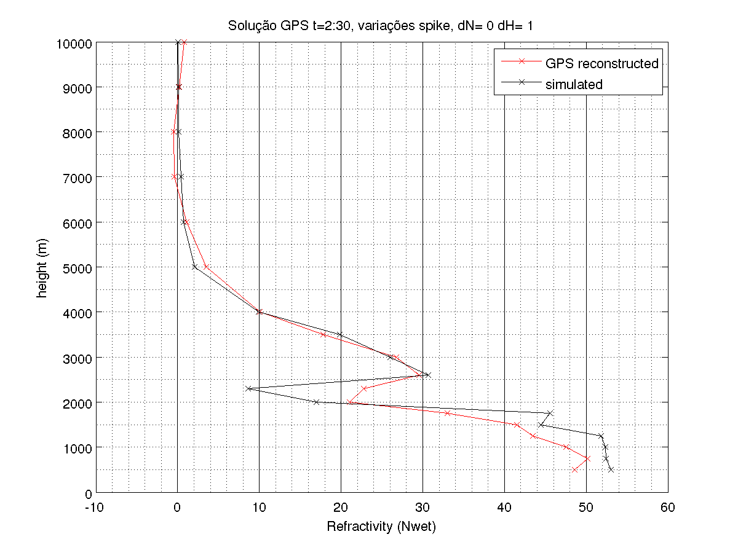
GNSS tomography: GPS + Galileo

