Slide 1


Cloud computing application for water resources based on open source software and open standards – a prototype
Blagoj Delipetrev
Faculty of Computer Science
University Goce Delcev
Republic of Macedonia
BigSkyEarth meeting14th - 17th April 2016, Brno

Slide 2
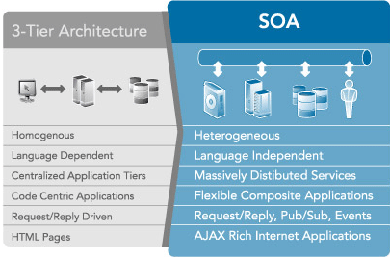
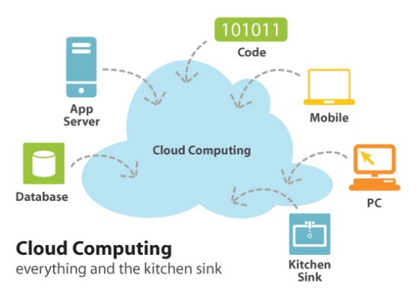
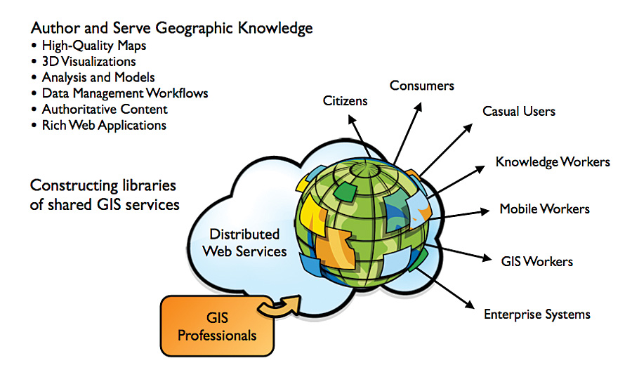
Cloud computing application for water resources Pilars
Pillars are: Cloud computing, Service Oriented Architecture (SOA) and Web GIS
BigSkyEarth meeting14th - 17th April 2016, Brno

Slide 3
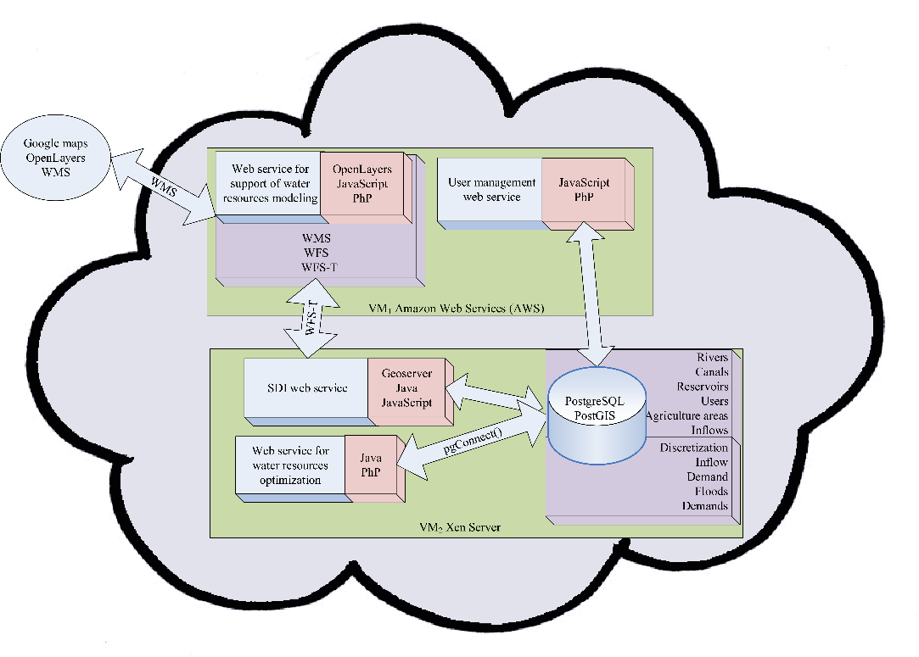
Architecture
Two Virtual Machines (VM) and four web services
BigSkyEarth meeting14th - 17th April 2016, Brno

Slide 4
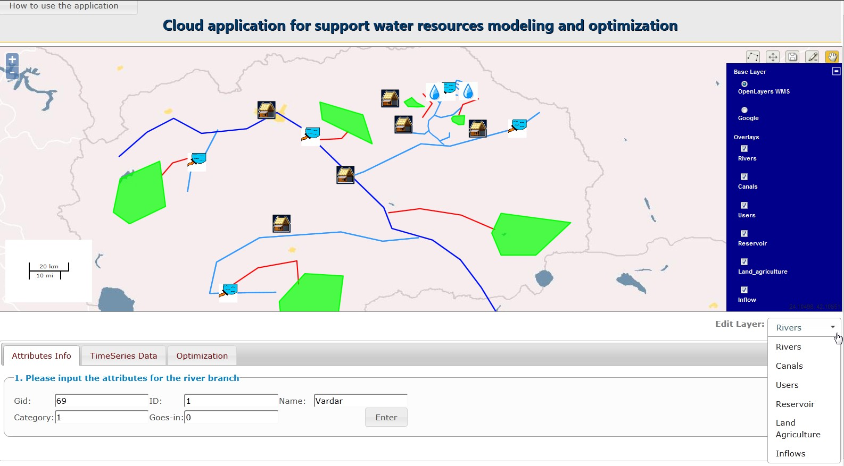
Cloud application interface
http://79.99.60.35/prototype
BigSkyEarth meeting14th - 17th April 2016, Brno

Slide 5
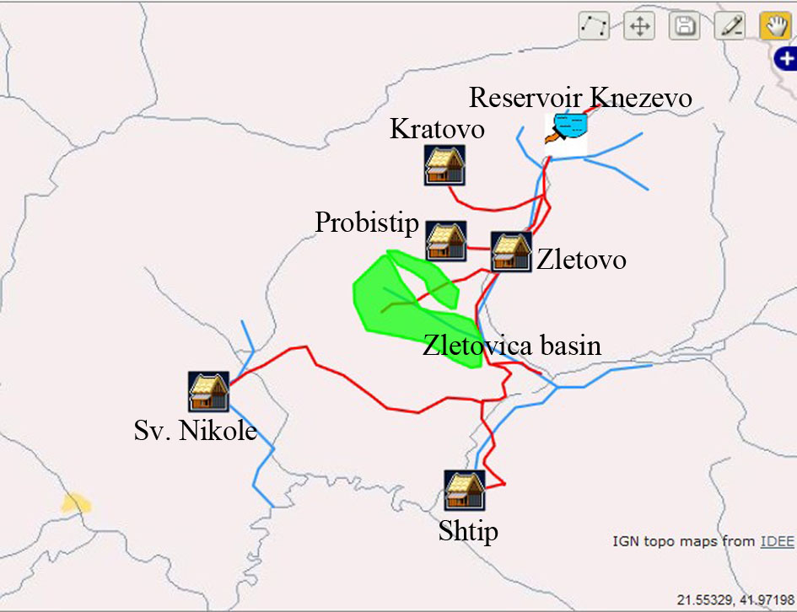
Web service for water resources modeling
BigSkyEarth meeting14th - 17th April 2016, Brno

Slide 6
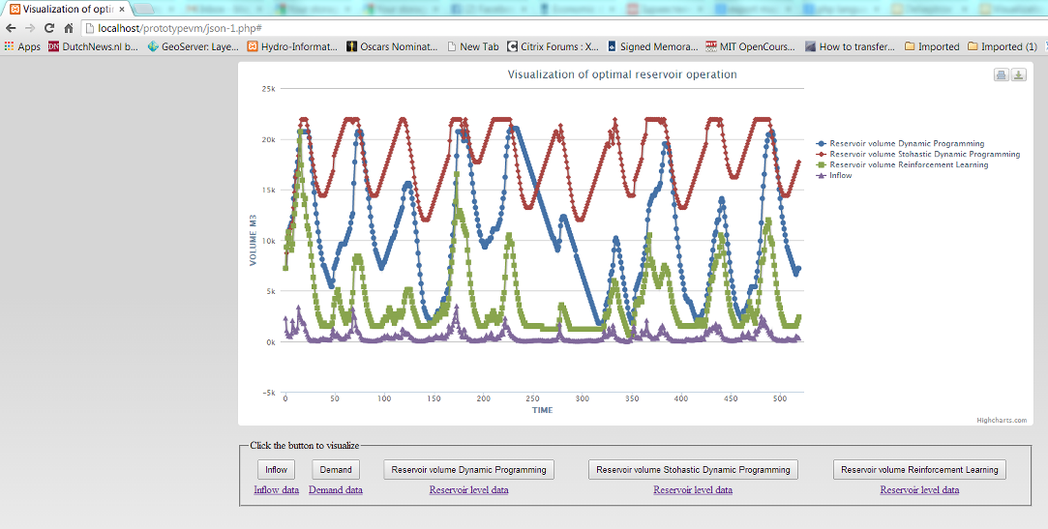
Web service for water resources optimization
(reservoir optimization)
Novel reservoir optimization algorithms (coded in Java)
Nested Dynamic programming
Nested Stochastic dynamic programming
Nested Reinforcement learning
Multi-objective optimization algorithms
BigSkyEarth meeting14th - 17th April 2016, Brno

Slide 7
Optimization algorithm and machine learning
Developing optimization algorithms
How to enhance DP/SDP/RL algorithm and develop new algorithm (methodology) that is flexible with including additional objectives (like cities water demand, agriculture water demand, ecology water demand, hydro power production and etc), alleviate as much as possible the curse of dimensionality and computational cost?
One step of the DP algorithm.
One step of the nDP algorithm
Movie Inception, a dream into a dream (into a dream)
BigSkyEarth meeting14th - 17th April 2016, Brno

Slide 8

Optimization algorithms and machine learning
Consultants in workforce optimization (Genetic algorithms, tabu search, simulated annealing, greedy algorithms)
Expertise in Reinforcement learning & Artificial neural networks (ANN)
Same methods used by DeepMind and Go game.
Decision trees, etc.
BigSkyEarth meeting14th - 17th April 2016, Brno

Slide 9

(relatively) New technologies and possibilities
Things are moving fast
NoSQL technologies
Too many options and varieties
MongoDB
Hadoop, Hive etc.
RasDaMan
Cloud
Amazon Web Services
Google Cloud Platform
and many others
(hybrid clouds)
Free and open source is winning !!!!
Facebook, Google, Microsoft (and others)
Increasingly open their projects (and source code)
Machine learning & AI
Tensorflow
Deep Learning
Convolution neural networks
Winning GO against humans (RL + Deep Learning)
"I think there is a world market for maybe five computers."
Thomas Watson, president of IBM, 1943
BigSkyEarth meeting14th - 17th April 2016, Brno

Slide 10

Thanks
Cloud is the future. Browser is the new desktop.
It is Machine learning time.
Open for collaboration
Cloud
Machine Learning
IoT
Big Data
BITT Solutions
http://bitt.solutions/
Multiple projects.
blagoj.delipetrev@ugd.edu.mk
Blagoj.delipetrev@bitt.solutions
BigSkyEarth meeting14th - 17th April 2016, Brno

